Slide 1

Deep fake real-time detection
By Group 4.
Ajay P Reji, Arjun Joshi M, Arjun V M, Sahul M S, Dominic Johnson

Slide 2
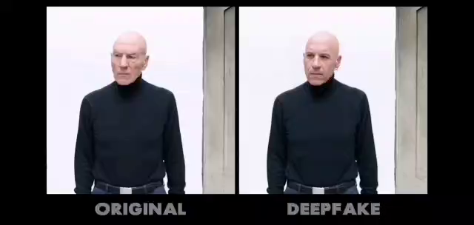
introduction
Deepfake is a technique for human image synthesis based on artificial intelligence.
Deepfake are created by combining and superimposing existing images and videos onto source images and videos onto source images or videos using a deep learning technique known as generative adversarial network or unlearned methods.

Slide 3
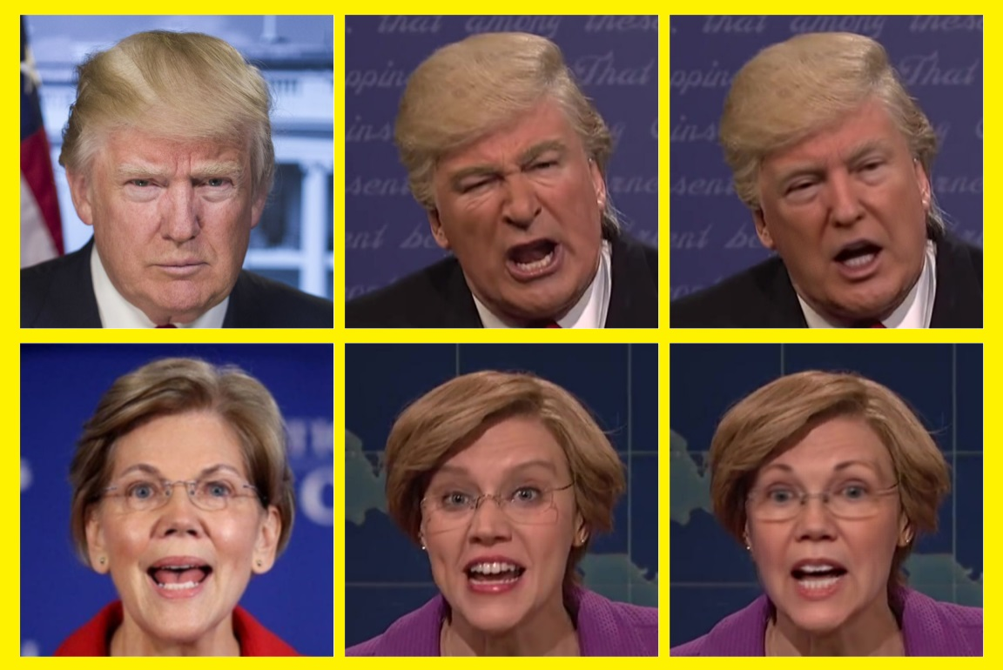

Slide 4
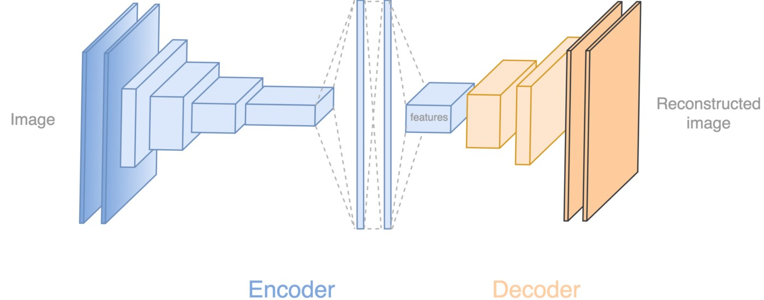
How deep fakes are created?
Tools for creating deep fake creation:
Face swap
Faceit
Deepfacelab
deepfakeCapsuleGAN
Large resolution facemask

Slide 5
Why deep fake detection?
Fake news
Malicious hoaxes
Financial fraud
Celebrity unsual video
Revenge porn
Politician videos

Slide 6
PROPOSED SOLUTION
The proposed solution is a real-time DeepFake detection system utilizing webcam feeds.
It combines face detection, recognition, and feature extraction techniques to classify faces as real or DeepFake.
Users can toggle the detection functionality on and off, and detected faces are annotated in real-time with labels indicating their classification.
The system provides a user-friendly interface built using Streamlit, enabling easy interaction and monitoring of potential DeepFake content.

Slide 7
Contd….
Given our project's necessity for real-time detection of deepfakes in live feeds, we implemented deepfake generation techniques for instantaneous face swapping in video streams.
We continuously capture video frames using OpenCV's VideoCapture. Pre-trained models detect faces and landmarks, crucial for accurate alignment. The face_swap module swaps faces by warping and blending them seamlessly. This real-time process occurs within a while loop, enabling smooth processing. Finally, Streamlit's st.image() function displays frames with swapped faces for live viewing.

Slide 8
Contd….
Additionally, the usage of ONNX (Open Neural Network Exchange) can optimize and export the deep learning models involved in face detection, alignment, and swapping.
By converting these models to ONNX format, we were able to deploye and execute the face swapping function efficiently across our hardware platforms. This not only ensures faster inference and better performance but also enables interoperability across various deep learning frameworks, facilitating seamless integration into the face swapping pipeline.

Slide 9
Our detection model
Our detection model is carefully designed to tell apart real content from DeepFake content. We went through several important steps to make sure it works well and can spot fake media accurately.
Data Acquisition and Preprocessing:
The first step involves gathering a diverse dataset of both real and DeepFake videos. These videos are then preprocessed to extract relevant frames and prepare them for analysis.

Slide 10
Feature Extraction:
Feature extraction is a crucial step where meaningful features are extracted from the preprocessed images. This involved utilizing deep learning technique Res-Net50 to extract high-level features that capture the distinguishing characteristics of DeepFake and real faces.
Feature Selection using PCA:
In this step, Principal Component Analysis (PCA) is applied to reduce the dimensionality of the extracted features while preserving the most important information. PCA helps in selecting the most discriminative features that contribute significantly to differentiating between real and DeepFake faces.

Slide 11
Model Training:
With the extracted features, a machine learning model is trained to distinguish between real and DeepFake faces. This involved algorithm that is Support Vector Machines (SVM) for faster classification.
Model Evaluation:
The trained model is then evaluated using a separate test dataset to assess its performance metrics such as accuracy and F1 score. This step ensures that the model generalizes well to unseen data and effectively identifies DeepFake content while minimizing false positives.

Slide 12
Deployment and Integration:
Once the detection model is trained and validated, it can be deployed into production environments where it can be integrated into various applications and systems to identify and flag DeepFake content in real-time.

Slide 13
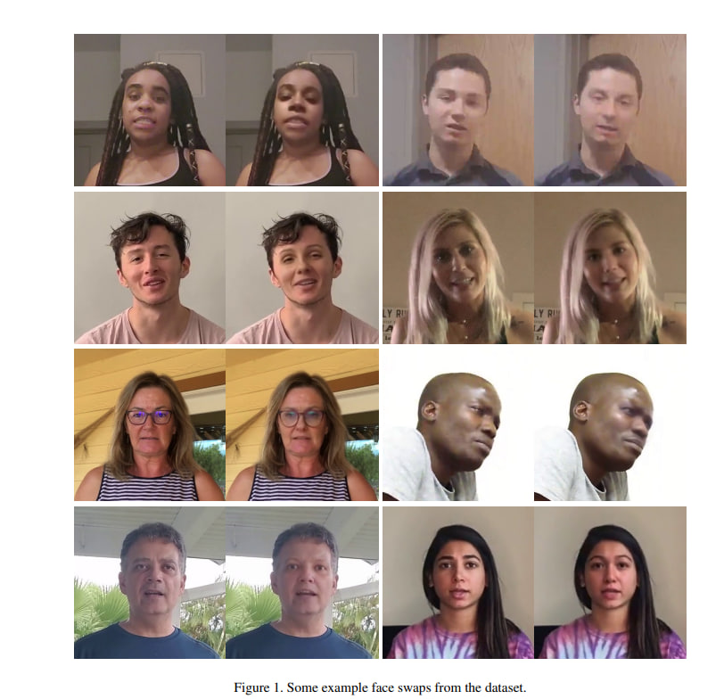
1.Data Acquisition and Preprocessing
Data acquisition involves downloading the dataset, extracting frames from videos, detecting faces, and saving them to Google Drive.
Dataset: The data set used here is the DFDC, This is an extensive face swap video dataset from the DeepFake Detection Challenge (DFDC) Kaggle competition to counter the emerging threat of Deepfakes. This dataset utilizes various GAN-based, and non-learned methods to generate deep fake.

Slide 14
From the downloaded dataset frames are extracted from the video file using OpenCV's cv2.VideoCapture() and cap.read() functions, then converted from BGR to RGB before releasing the video capture object.
Faces are detected in each frame using face recognition library, then extracted and resized to 224x224 pixels, and finally saved in directories labeled as 'fake' or 'real' based on their classification.
The extracted faces are then saved in a directory

Slide 15
Data preprocessing includes reading the saved images, processing them, and encoding the labels.
The various steps included here are:
After reading the saved face images from the Google Drive directories. Iterate through the images and load them to ensure the images have three channels(RGB).
Append the images and their corresponding labels (fake or real) to lists.
Labels are encoded into numerical format using LabelEncoder(), facilitating their utilization in machine learning models for effective training and analysis.

Slide 16
2.FEATURE EXTRACTION
We have used the pretrained ResNet50 model for the feature extraction of the acquired data.
The ResNet50 model is used as a feature extractor to capture high-level features from face images. These features can then be fed into additional layers for classification in our deepfake detection task.
Pre-trained ResNet models, such as the one obtained from ImageNet, offer a strong starting point for transfer learning. Transfer learning involves leveraging features learned from a large dataset (like ImageNet) and fine-tuning them for a specific task, requiring less training data and time.

Slide 17
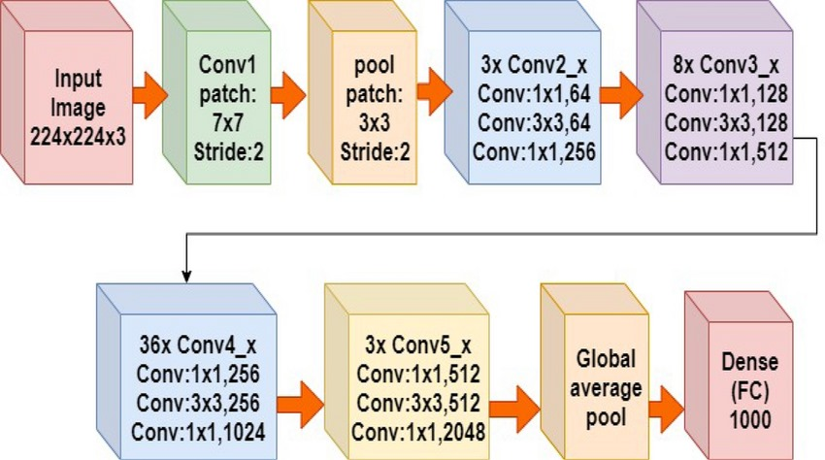
Architecture of Resnet 50 :

Slide 18
Contd….
ResNet introduces residual blocks, where the input to a layer is combined with its output, facilitating the flow of gradients during backpropagation. This helps in training deeper networks more effectively.
We have created a new model, rnet_model, which inherits all the layers from the pre-trained ResNet50 model (rnet_model) except for the input and output layers. These layers are essentially "cut off", leaving only the intermediate layers for feature extraction or further processing.

Slide 19
3.FEATURE SELECTION USING PCA
PCA is used to reduce the dimensionality of the extracted features from the ResNet50 model.
By reducing the dimensionality of the features, PCA effectively selects the most important components that contribute the most to the variance in the data. In this case, it selects 20 principal components that capture the maximum variance in the original feature space.
By reducing the dimensionality of the features, PCA effectively selects the most important components that contribute the most to the variance in the data. In this case, it selects 20 principal components that capture the maximum variance in the original feature space.

Slide 20
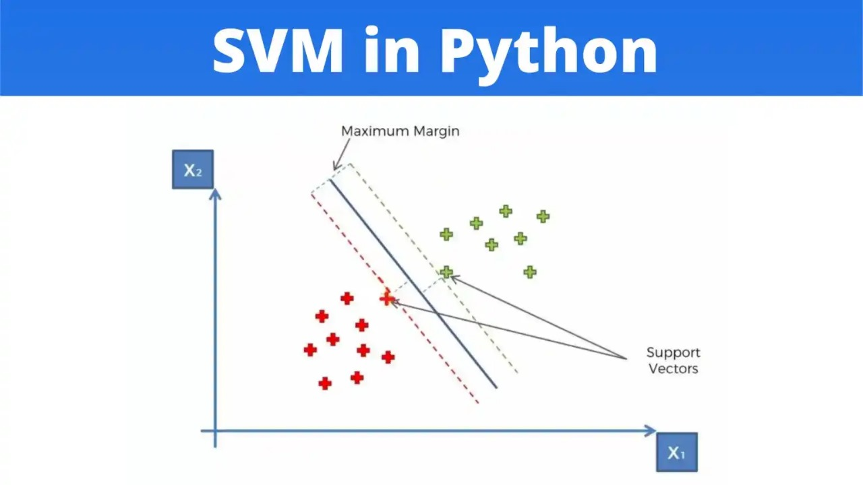
4.Model training
Features are extracted from the input data. Each input image in the data array is processed to obtain its corresponding feature vector, and these feature vectors are stored in the features list.
In this training process a Support Vector Machine (SVM) classifier is trained using the extracted features and their corresponding labels.
The SVC class from scikit-learn is used to create an SVM classifier instance.

Slide 21
Contd….
The fit() method is applied to the SVM classifier, where it learns from the extracted features and their corresponding labels.
During this process, the classifier adjusts its parameters to minimize classification errors and maximize accuracy on the training data.
This step essentially teaches the SVM classifier to distinguish between different classes based on the patterns and features present in the input data, allowing it to make predictions on new, unseen data.
SVMs are used in deepfake detection for their ability to effectively discriminate between real and fake content, handle high-dimensional data, and perform binary classification tasks.

Slide 22
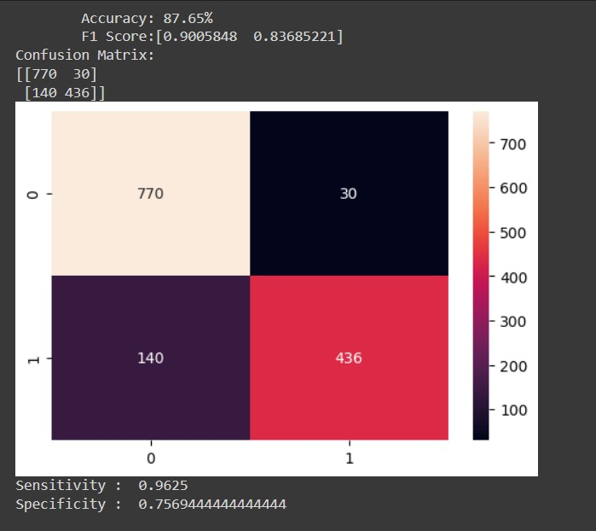
5.Model Evaluation
The performance of our trained model is evaluated using various metrics and visualizations:
Accuracy
F1 Score
Confusion matrix
Sensitivity
Specificity

Slide 23
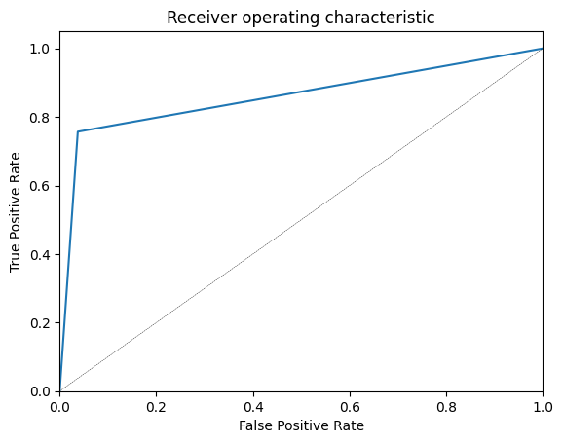
ROC curve

Slide 24
6. DEPLOYMENT AND INTEGRATION
Streamlit Web Application: Deployed as a user-friendly web app for real-time deepfake detection.
User Interface: Allows users to choose camera source and activate deepfake detection with checkboxes.
Model Integration: Includes an SVM-based deepfake detection model loaded from a saved file.

Slide 25
Contd….
Face Swap and Landmark Detection: Integrates face swapping and landmark detection for realtime deepfake generation
Real-time Feedback: Provides live webcam feed with overlaid detection results.
Speech Alerts: Generates speech alerts for deepfake detection using text-to-speech conversion.
User Interaction: Users can interact with the app by starting the webcam feed and enabling detection.

Slide 26
Tools used
Streamlit
Used for building interactive web applications for machine learning and data science tasks. It simplifies the process of creating web interfaces for your Python code.
OpenCV (cv2):
It is a popular library for computer vision tasks. It provides various functionalities for image and video processing, including reading/writing images, webcam access, face detection, and more.

Slide 27
dlib:It is a C++ toolkit containing machine learning algorithms and tools, primarily for computer vision tasks. It's used here for face detection and facial landmark detection.
scikit-learn: It is a machine learning library in Python, Here it is used for loading a pre-trained model, feature extraction, and PCA (Principal Component Analysis).
TensorFlow and Keras :Here it utilized to load a pre-trained ResNet50 model for feature extraction. TensorFlow offers scalability for deep learning model development, while Keras simplifies neural network construction. This integration facilitates efficient image feature extraction, enhancing the application's DeepFake detection capabilities.

Slide 28
UML DIAGRAMS
USE CASE
SEQUENCE

Slide 29
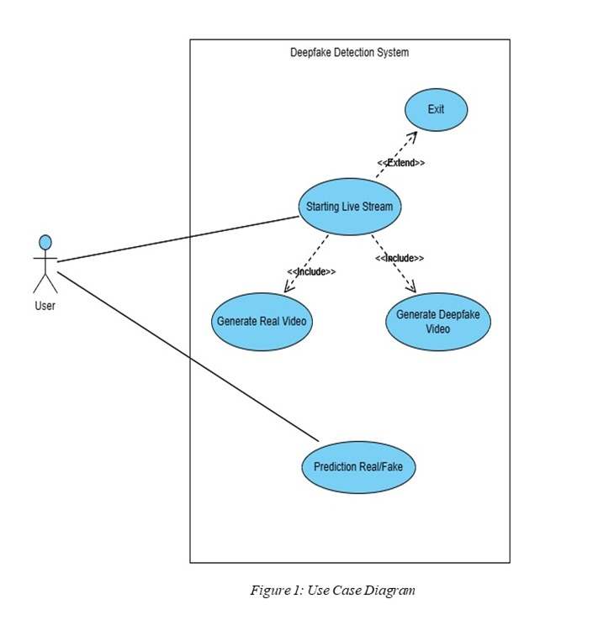
USE CASE DIAGRAM

Slide 30
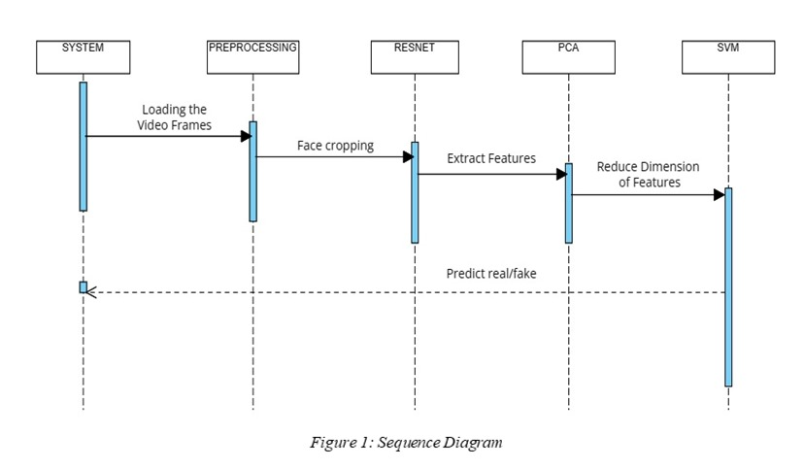
SEQUENCE DIAGRAM

Slide 31
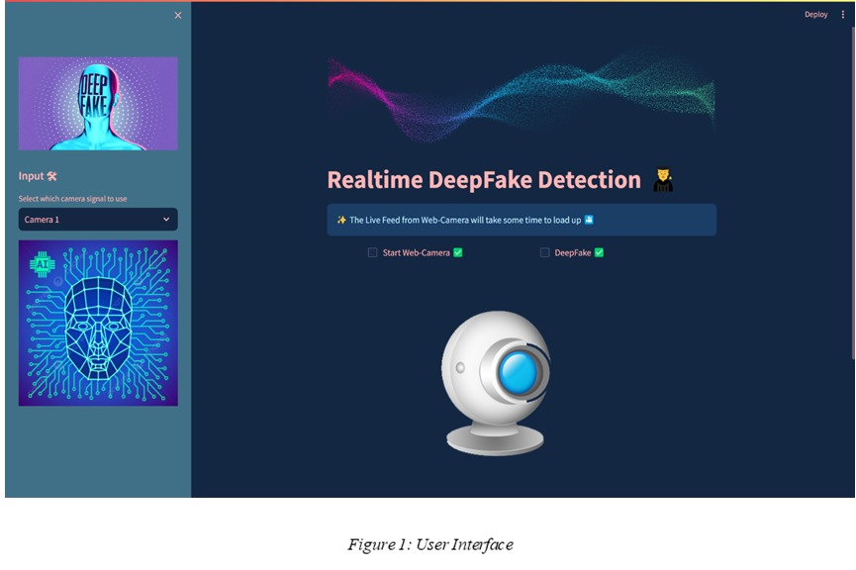
APP UI

Slide 32
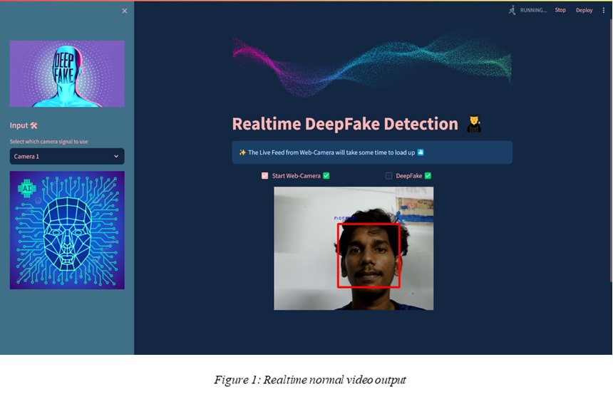
Normal video output

Slide 33
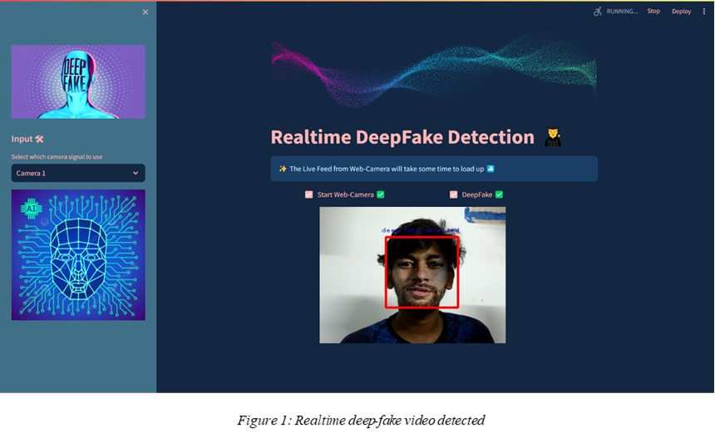
Detection of deepfake video output

Slide 34

FUTURE SCOPE OF THIS PROJECT
Currently only Face Deep Fakes are being detected by the algorithm, but the algorithm can be enhanced in detecting full body deep fakes.
Integrate various modalities such as audio, facial expressions, and contextual information to enhance the robustness of the detection system. This can help in detecting more sophisticated Deepfake techniques.

Slide 35
THANK YOU

